Slide 1
Machine learning methods

Slide 2
What is machine learning?
It is defined as the ability to learn by computers or machines without explicitly programmed
A branch of artificial intelligence, concerned with the design and development of algorithms that allow computers to evolve behaviors based on empirical data.
As intelligence requires knowledge, it is necessary for the computers to acquire knowledge.

Slide 3
Machine Learning
Machine learning (ML) is a field of artificial intelligence where systems learn from data
to identify patterns,
make predictions, and
improve performance over time without being explicitly programmed.
Using algorithms, these systems are trained on large datasets to find correlations and make informed decisions, with their accuracy increasing as they process more data.

Slide 4
Machine Learning
Data Training:
Algorithms are fed massive amounts of data relevant to a task.
Pattern Identification:
The algorithms analyze this data to find patterns, relationships, and insights.
Model Creation:
The learning process results in a "model" that represents the learned knowledge from the data.
Prediction and Decision-Making:
The trained model can then make predictions or decisions on new, unseen data, similar to how it learned from the training data.
Continuous Improvement:
The model's performance improves as it is exposed to more data,
continuously refining its ability to make accurate predictions or decisions.

Slide 5
Machine Learning: Definition
Computer Program learns from
experience E
Some Class of Tasks T
Performance measure P
If P improves with E

Slide 6
Methods of learning
Learning from labelled data (supervised learning)
Eg. Classification, regression.
Learning from unlabelled data (unsupervised learning)
Eg. Clustering, visualisation, dimensionality reduction
Semi supervised Learning
Reinforcement Learning

Slide 7
Supervised Learning
Classification : mapping the data items into set of Boolean classes.
Predicting the data item on a Boolean class.
(0,1)(true,false)(yes,no)(get_pl,notget_pl)(diseased,not_diseased)(loan_sanctioned,not_sanctioned) 60 placements =23 no _placements=25
12 missing are misclassified data.
48/60*100=80%
Regression
Predicting the data item on a continuous scale.
Interval [0,1] continuous[0.0,0.1,0.2…..1.0]
predicting a medicine.0.75mg 0.98mg

Slide 8
Classification techniques
Bayesian theorem (statistical Learning)
Decision trees (Inductive Learning)
Random forest method
Support Vector Machines
Artificial Neural Networks
Multilayer Perceptrons
Backpropagation Neural Networks
K nearest Neighbour hood algorithms
Ensemble Learning (Boosting, Bagging, Boot Strapping)
Logistic regression

Slide 9
Regression techinique
Linear regression
Single linear regression (single
Multiple linear regression

Slide 10
Unsupervised Learning
Class labels are not priorly known.
No clarity of Data.
We can make the data into set of groups.
Or Clusters.
This grouping is based on similarity(fruit basket)
Distance.
Euclidean distance d
Manhattan Distance

Slide 11
Unsupervised learning methods
Clustering=grouping
Association Rules
Milk
Bread
Eggs
Meat
Vegetables
Food items

Slide 12
Clustering Techniques
K-means
Density Based
DBSCAN
Artificial Neural Networks
Kohenen Neural networks
Hopfiled Neural networks

Slide 13
Semisupervised Learning
It is the combination of both supervised and unsupervised learning techniques.
Ex:Deep learning
First Unsupervised learning can be done then it applies supervised learning.

Slide 14
Reinforcement Learning
Agents
PEAS
P-Performance
E-Environment
A-Actutators
S-Sensors
Ex - Human agents
Machine agents
Robo Agents

Slide 15
Reinforcement Learning
Agent is given a task
If success it is rewarded
Else
It is punished/redoing the same task
Q-learning

Slide 16
Deep learning
Associated with ANN.
ANN structure
Input layer
Output layer
Hidden layer
It can have more layers as hidden.
Hidden layer can have more amount of Data.
Recurrent NN
Convolutional NN.
It is a part of ML

Slide 17
Relation Between AI,ML and DL
DL is subset of ML
ML is the subset of AI
AI is the superset of both DL and ML.

Slide 18
Statistical Learning(SL)
One kind of Supervised Learning.
Prediction can be based on Statistical Methods.
Bayesian Theroem
Probability
Bayesian Belief Networks
Classification method.
Ex:1.Grass wet due to rain or sprinklers.
Ex.2.Ship Alarm ringing.
Statistical learning to handle uncertainty.

Slide 19
Inductive Learning
F(x)=x1,x2,x3,x4…xn.
At any one of the particular value the f(x) can get satisified.
This feature is Inductive learning
It is a Supervised learning method.
Decision tree algorithm.
Random forest algorithm.
This inductive learning is taken from mathematical induction.
X2+2x+1=0 (1—n)

Slide 20
Major techniques
Supervised learning
Unsupervised learning
Semi-supervised learning

Slide 21
Training and Testing
Data acquisition
n
Practical T
Universal set
(unobserved)
Training set (observed)
Testing set
(unobserved)

Slide 22
Training and Testing
PrTraining data will act as model data.
actical data is the testing data.
Training data shoul be more.
In a data set 100 tuples we have 70/80 training and 30/20 for testing.

Slide 23
Training and Testing
To prevent overfitting and underfitting.
Testing unknown or unseen tuples to the model.
More training data more accurate results.
By using training data the model can get knowledge.

Slide 24
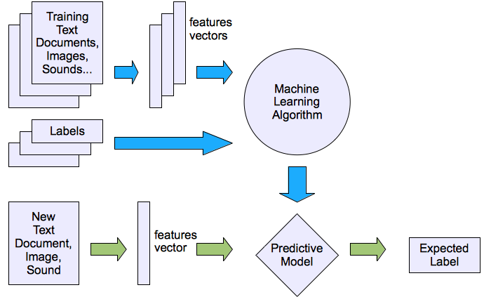
Supervised Learning

Slide 25
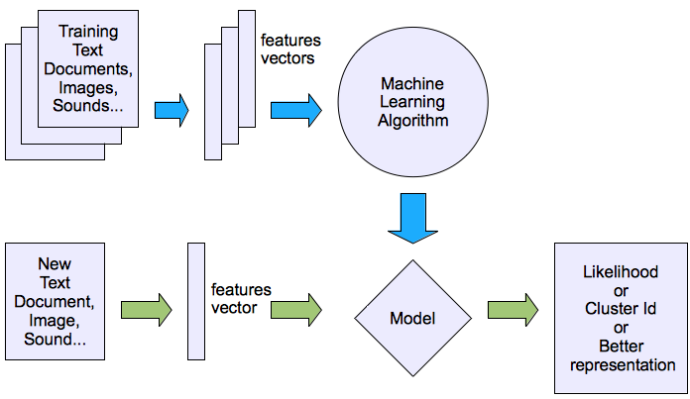
Unsupervised Learning

Slide 26
Semi supervised learning
A combination of both supervised and unsupervised methods .
Initially supervised learning can be done then unsupervised learning can be done.

Slide 27
Reinforcement Learning
Learning a policy: A sequence of outputs
No supervised output but delayed reward
Credit assignment problem
Game playing
Robot in an environment
Multiple agents,
partial observability

Slide 28
Inductive learning
A supervised learning method or classification.
Given examples of a function (X, F(X))
Predict function F(X) for new examples X
Discrete F(X): Classification
Continuous F(X): Regression
F(X) = Probability(X): Probability estimation
Best Example is Decision Tree.

Slide 29
Machine learning libraries
Top 10 Python Libraries for Machine Learning algorithms……
NumPy. (Numerical Python)
SciPy. (Scientific Python)
Scikit-learn. (Scientific python and an open source for machine learning algorithms)
Theano. (used for mathematical operations in Python).

Slide 30
Machine learning libraries
TensorFlow.(open source for Machine Learning and Artificial Intelligence).
Keras. Keras is a deep learning API written in Python, running on top of the machine learning platform TensorFlow.
PyTorch. PyTorch is a machine learning framework based on the Torch library, used for applications such as computer vision and natural language processing.

Slide 31
Machine learning libraries
Pandas. Stands for Python Data Analysis and used to analyze the data.
Matplotlib—data visualization purpose
Seaborn—data visualization purpose

